Slide 1


Capture The Flag
NAME: Misty keefe
Team Name: IOT (Intentionally overt technicians) Team 3
Notes:
Hello!
My name is Kristina Keefe, proud member of Team 3- IOT (Intentionally Overt Technicians). Project 2 turned out to be an exhilarating and captivating experience! The challenges presented were not only enjoyable but also incredibly intriguing.
In this new scenario, the manager at Centralia Technology has taken note of our responses in the individual CTF challenge and has assembled teams for us to collaborate on another set of CTF challenges. We needed to excel in solving the CTFs but also demonstrate our ability to work cohesively as a team.
I believe that team 3 effectively communicated and efficiently tackled the problems presented to us.

Slide 2
Introduction
The CTF Problem
Steps to Solve
The Solution
Workplace Relevance
<insert required narration>
Notes:
Real quick intro, were going to go over
The CTF Problem that I chose was OSINT open source intelligence
The steps of gathering, processing, and taking advantage are used to discover the answer
The solution will come from the tools that I used to find this information
The workplace relevance of OSINT enabling businesses to gather valuable insights on competitors, market trends, and cybersecurity threats from publicly available sources. It also aids in informed decision-making, effective marketing strategies, and risk assessment, enhancing overall efficiency and competitiveness.

Slide 3
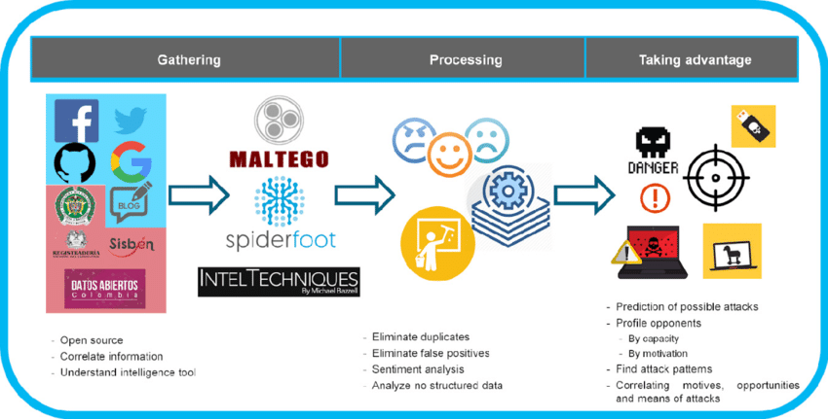
CTF Category Description
Open-Source Intelligence
Notes:
Describe the category of question that you attempted.
OSINT questions are challenges designed to test participants' skills in gathering and analyzing information from publicly available sources. These competitions often require contestants to utilize creative search techniques and critical thinking to uncover hidden data and solve puzzles related to real-world scenarios.
What is the important background knowledge needed?
To excel in Open Source Intelligence (OSINT), individuals should possess expertise in internet research techniques, social media proficiency, and knowledge of web technologies and geolocation. Strong analytical skills, ethical awareness, and an understanding of data privacy are also essential for conducting successful OSINT investigations.
How does this relate to the Ethical Hacking course?
In ethical hacking, Open Source Intelligence (OSINT) plays a vital role during the reconnaissance phase, enabling ethical hackers to gather publicly available information about a target to identify potential vulnerabilities and assess attack surfaces. This process ensures that ethical hackers operate within legal and ethical boundaries, aiming to enhance security and protect against cyber threats.
What lab in the course covered the topic from this CTF problem?
CEHv11-Assessments, Module 02, Foot printing and Reconnaissance.

Slide 4
Introduction to the Problem
In 1999, you could register for UMUC classes using touch-tone registration via IRIS. What was the phone number? Answer format: xxx-xxx-xxxx

Slide 5
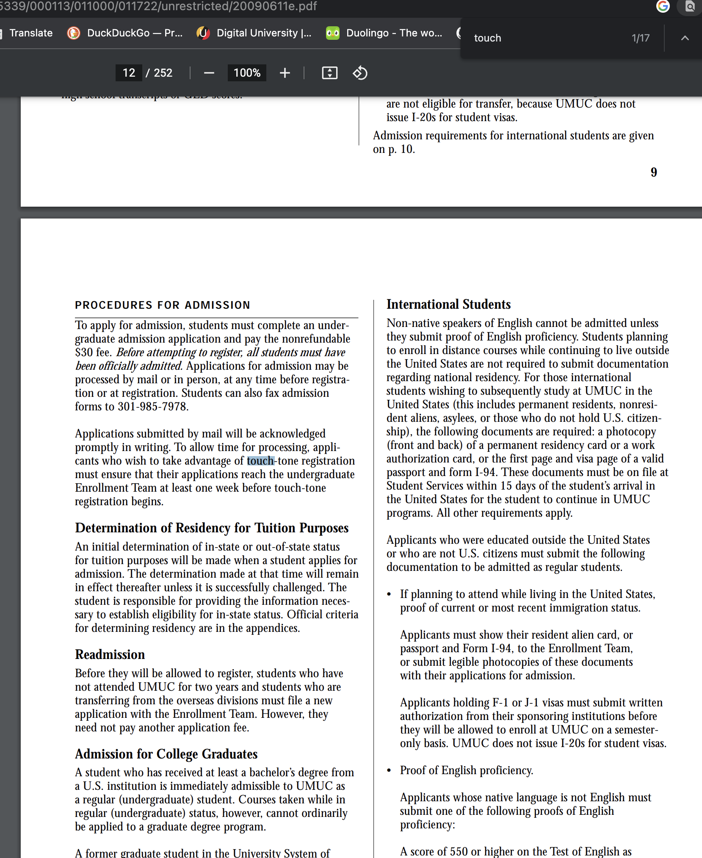
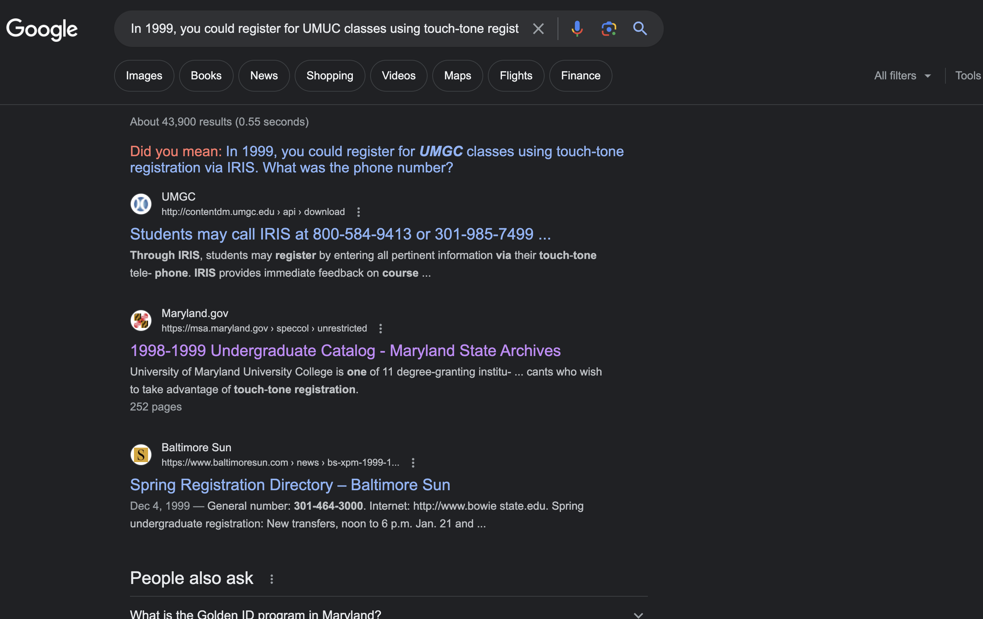
Working Toward a Solution
<insert required narration>
Notes:
I searched the internet with google dorking. Google dorking is the practice of using advanced search operators and specific queries to uncover hidden or sensitive information on the internet using the Google search engine. It can be used for legitimate research purposes but must be performed ethically and responsibly to avoid illegal or unethical activities.
Some of the best OSINT tools include Maltego, TheHarvester, and Shodan, enabling data mining, email gathering, and device information search. SpiderFoot, OSINT Framework, and FOCA are also valuable for automating reconnaissance and metadata extraction from documents. Always use OSINT tools responsibly and within legal boundaries to ensure ethical usage.
The best way to do Open Source Intelligence (OSINT) is to define clear objectives, select reliable sources, use advanced search operators, verify information, and stay ethical. Leveraging automation and staying informed about OSINT techniques further enhances the efficiency and effectiveness of the proces

Slide 6
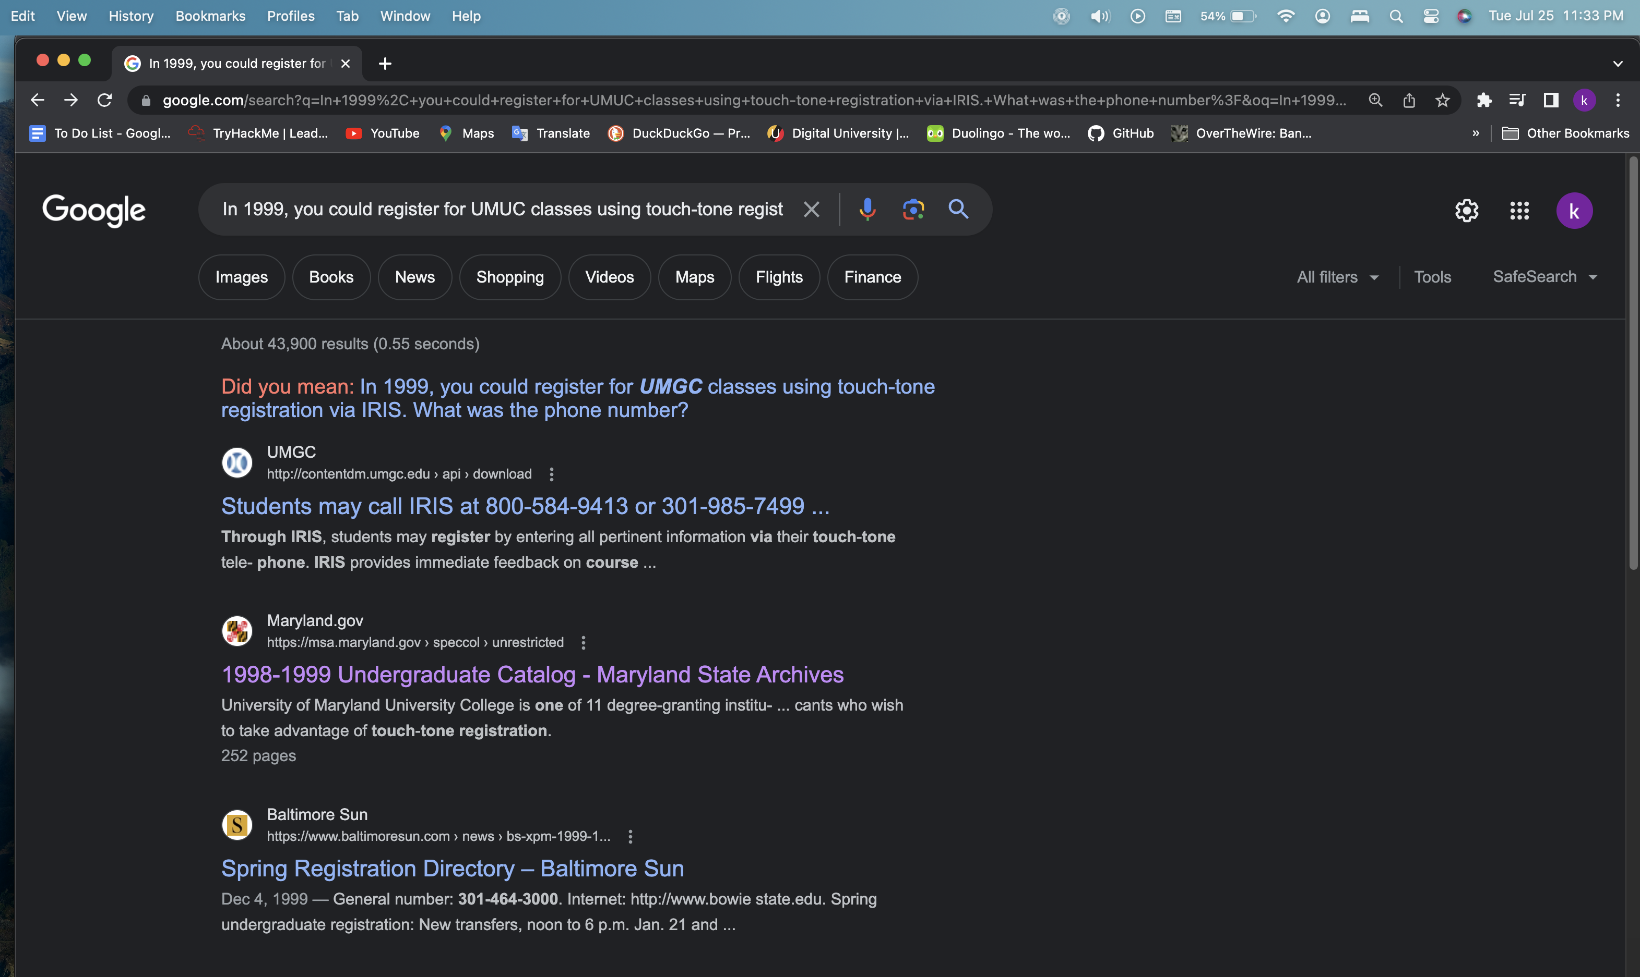
Arriving at the Solution
Notes:
The screenshot below includes the date/time from the host system.
In the results, search for the flag, in the format of answer format: xxx-xxx-xxxx
This provided me with the flag and allowed me to solve the OSINT problem for Team #3.

Slide 7
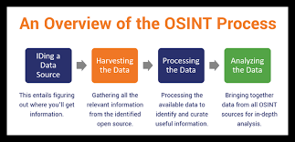
Strategies, Pitfalls, Lessons Learned
301-985-7179
301-985-7973
800-584-9413
301-985-7499 Solution
<insert required narration>
Notes:
Strategies used for OSINT (Open Source Intelligence) include advanced online searching with specialized operators and tools, social media analysis, and metadata examination. Web scraping, image and video analysis, and monitoring the dark web are also common techniques, along with WHOIS lookups, geolocation mapping, and network enumeration. Additionally, staying updated with threat intelligence feeds and engaging in ethical human intelligence (HUMINT) can provide valuable insights to support OSINT investigations.
Common pitfalls of OSINT include relying on unverified sources, neglecting data privacy concerns, and overlooking the use of specialized OSINT tools. Confirmation bias and information overload can hinder effective analysis, while failure to stay updated with evolving techniques can reduce the efficiency of OSINT investigations and lead to legal and ethical risks if boundaries are crossed.

Slide 8


The Relationship to the Workplace
Notes:
Participating in Capture the Flag (CTF) competitions benefits individuals in the workplace by fostering skill development in problem-solving, technical proficiency, and cybersecurity expertise. CTFs offer hands-on learning experiences, allowing participants to gain practical insights into real-world scenarios and challenges. Additionally, teamwork and collaboration skills are enhanced through group participation, encouraging effective communication and cooperation. Success in CTF competitions can lead to increased recognition, credibility, and networking opportunities within the cybersecurity and IT community, potentially opening doors to career advancement and new prospects.
Open Source Intelligence (OSINT) is highly relevant in the workplace, enabling businesses to gather valuable insights on competitors, market trends, and cybersecurity threats from publicly available sources. It also aids in informed decision-making, effective marketing strategies, and risk assessment, enhancing overall efficiency and competitiveness.

Slide 9


Summary
<insert narration>
Notes:
In the context of ethical hacking, OSINT (Open Source Intelligence) serves as a critical phase where publicly available information is gathered to understand a target's digital footprint, potential vulnerabilities, and attack surfaces. Ethical hackers use OSINT to ensure their actions are authorized, legal, and conducted within ethical boundaries, avoiding any unlawful or harmful activities. The process of OSINT enhances crucial skills like critical thinking, problem-solving, and technical proficiency, providing ethical hackers with valuable tools to assess and protect against cyber threats. This approach fosters a mindset of continuous learning, enabling ethical hackers to stay updated with the latest technologies, techniques, and potential risks, thus ensuring their effectiveness and relevance in defending against security challenges.

Slide 10
References
AL-Mogahed, O. (2022, May 11). OSINT Google Hacking. OSINTGURU. https://www.osintguru.com/blog/osint-google-hacking
OSINT framework. OSINT Framework. (n.d.). https://osintframework.com/
Ritu Gill. What is OSINT (Open-Source Intelligence?) | SANS Institute. (2023, July 6). https://www.sans.org/blog/what-is-open-source-intelligence/
Flashpoint. (2023, May 31). What is open source intelligence: The importance of OSINT in your organization’s threat landscape. Flashpoint. https://flashpoint.io/blog/what-is-osint-open-source-intelligence/
<insert narration>

